Slide 1

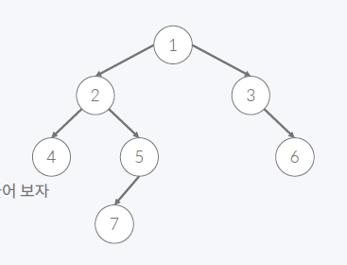
트리의 순회
Preorder 1 2 4 5 7 3 6
Inorder 4 2 7 5 1 3 6
Postorder 4 7 5 2 6 3 1
LEFT
RIGHT
Inorder
Postorder
4 | 2 | 7 | 5 | 1 | 3 | 6
4 | 7 | 5 | 2 | 6 | 3 | 1
LEFT
RIGHT

Slide 2
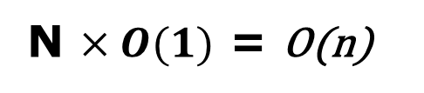
트리의 순회
4 | 2 | 7 | 5 | 1 | 3 | 6
N $×O(1)$ = O(n)
4 | 7 | 5 | 2 | 6 | 3 | 1
LEFT
RIGHT
RIGHT
4 | 2 | 7 | 5
7
3 | 6
4 | 7 | 5 | 2
6 | 3
LEFT
RIGHT
RIGHT
LEFT
4
6
7 | 5
4
GetSome(In_start, In_end, Post_start, Post_end)
root = Postorder[Post_end]
HowmanyLeft = In_root - In-start
7 | 5
LEFT
7
LEFT
GetSome(In_start, In_root-1, Post_start, Post_start + HowmanyLeft - 1)
RIGHT

